Slide 1
BROWN-EYED NOT ALLOWED

Slide 2
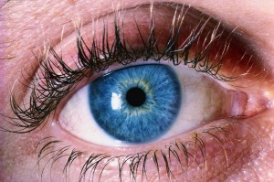
BLUE-EYED ONLY!!!

Slide 3
WARNING
BROWN-EYED PEOPLE HERE

Slide 4
BROWN-EYED PEOPLE MUST NOT SPEAK

Slide 5
BLUE-EYED PEOPLE ARE IN CHARGE!

